Slide 1
MTNL Website Testing

Slide 2
TABLE OF CONTENTS
Functional Testing
Navigation Testing
Cross Browser Testing
Form Based Testing
Performance Testing
Database Testing
Security Testing

Slide 3
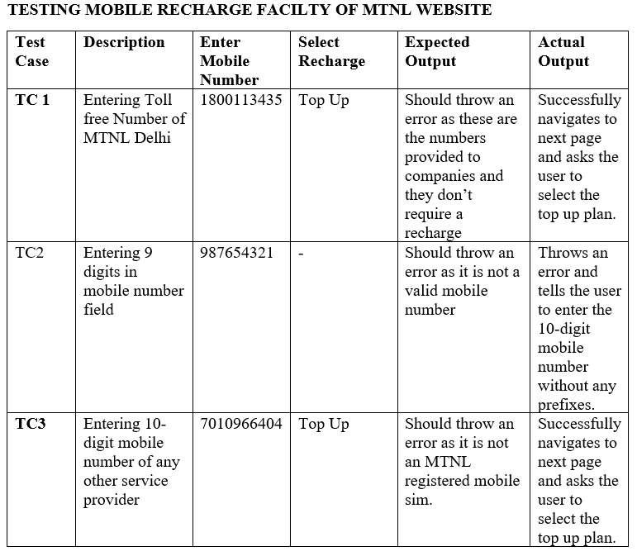
Functional Testing

Slide 4
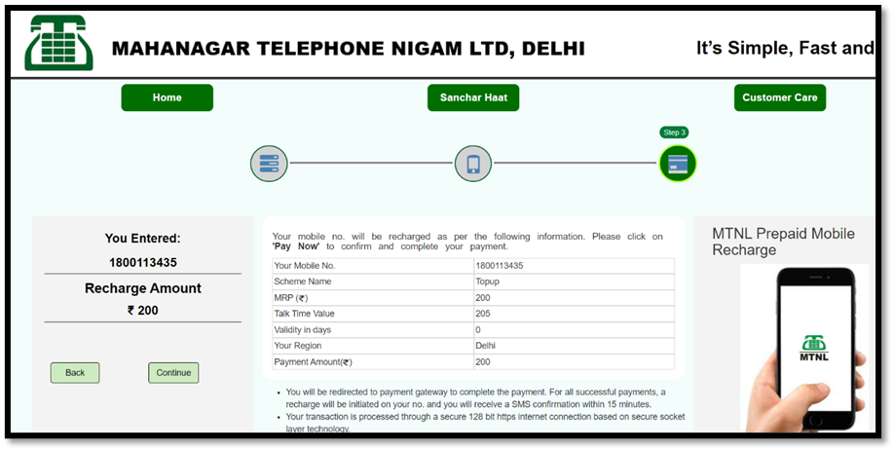
Functional Testing
Fault 1: Accepting Toll Free Numbers for Recharge

Slide 5
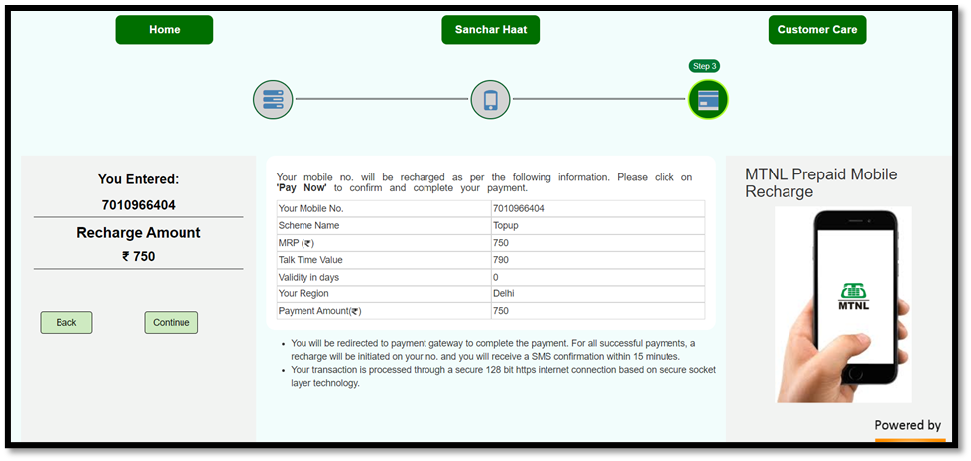
Functional Testing
Fault 2: Accepting Mobile Numbers of other Mobile Service Providers

Slide 6
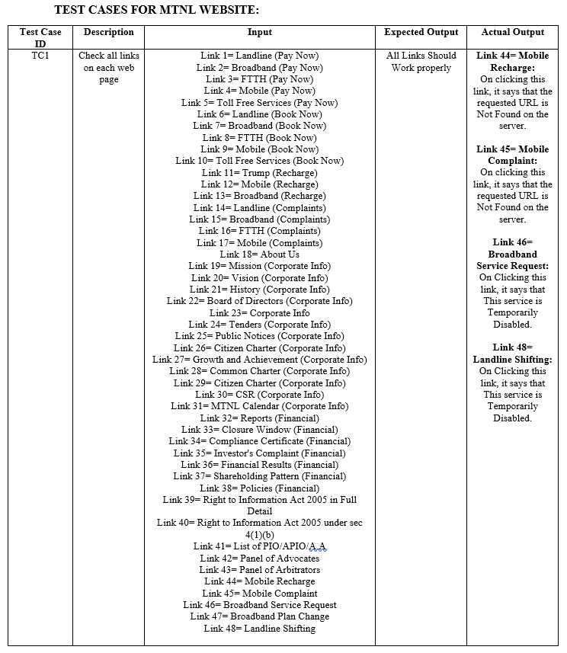
Navigation Testing

Slide 7
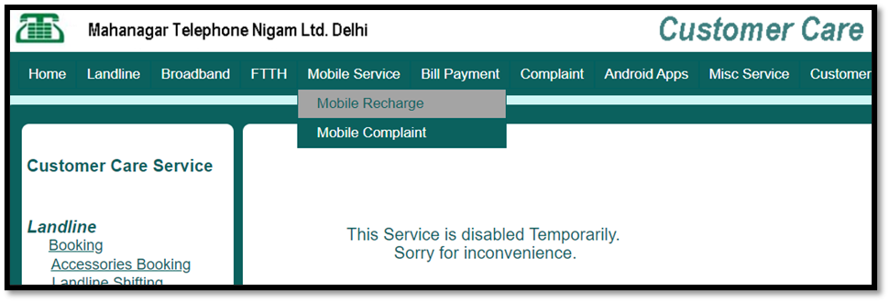
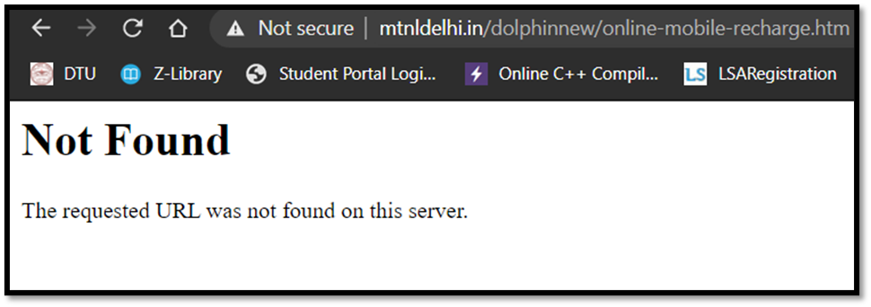
Navigation Testing
1. Link 44= Mobile Recharge

Slide 8
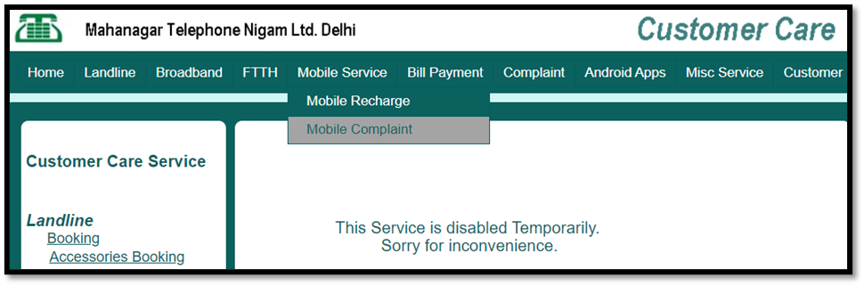
Navigation testing
2. Link 45= Mobile Complaint

Slide 9
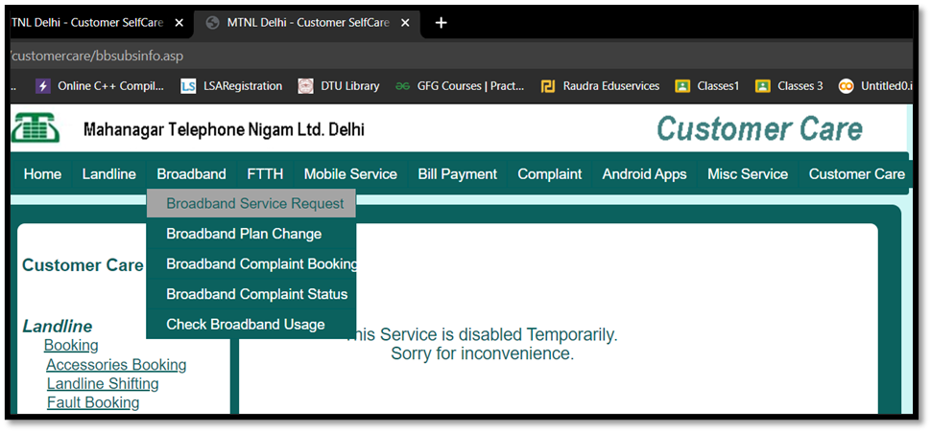
Navigation testing
3. Link 46= Broadband Service Request

Slide 10
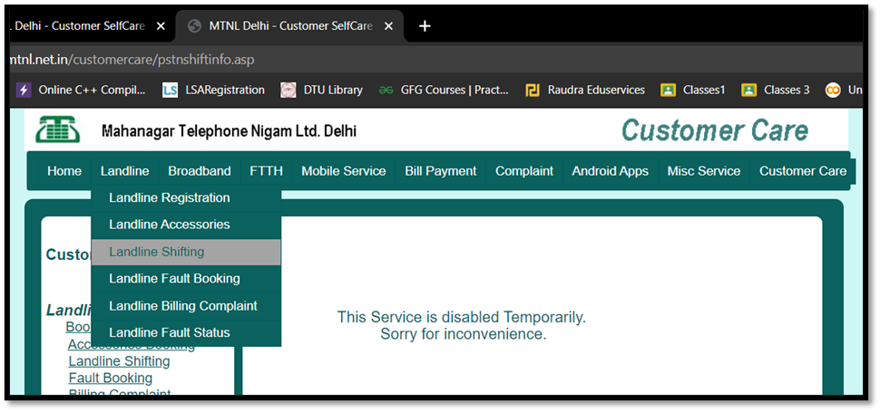
Navigation testing
4. Link 48= Landline Shifting

Slide 11
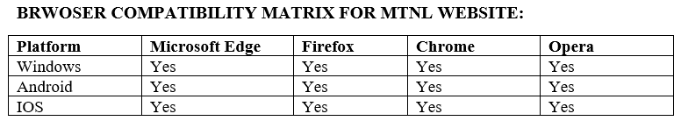
Cross browser testing

Slide 12
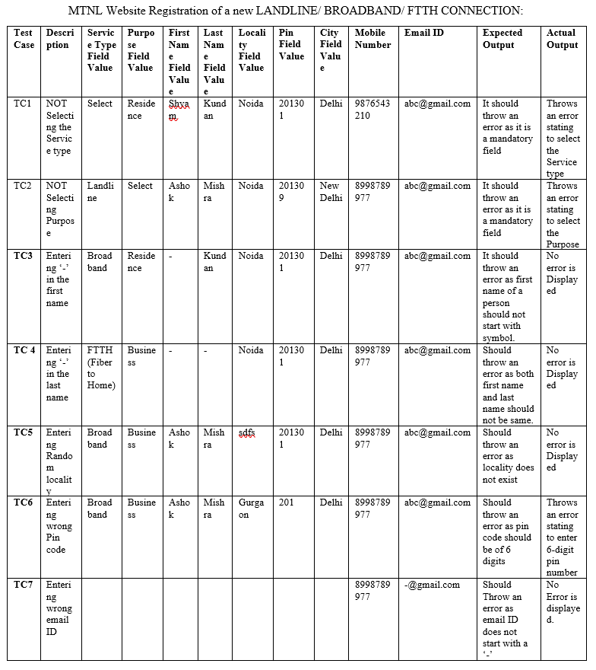
Form based testing

Slide 13
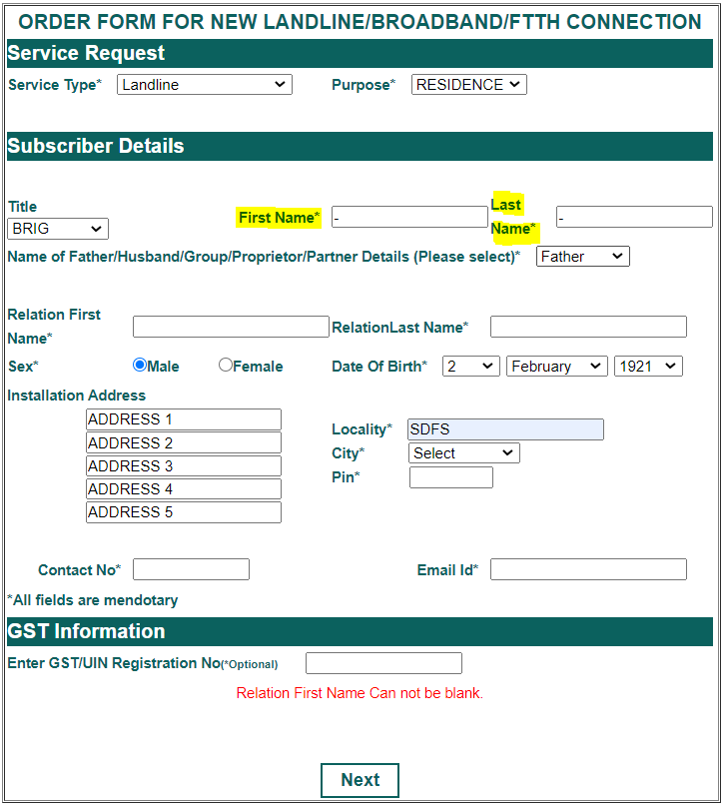
Form based testing
Fault 1: Accepting blanks in First name and last name

Slide 14
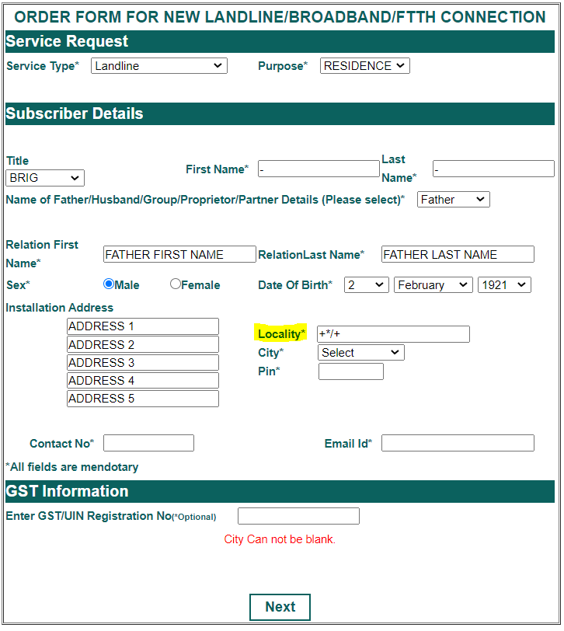
Form based testing
Fault 2: Accepting Symbols in Locality Field

Slide 15
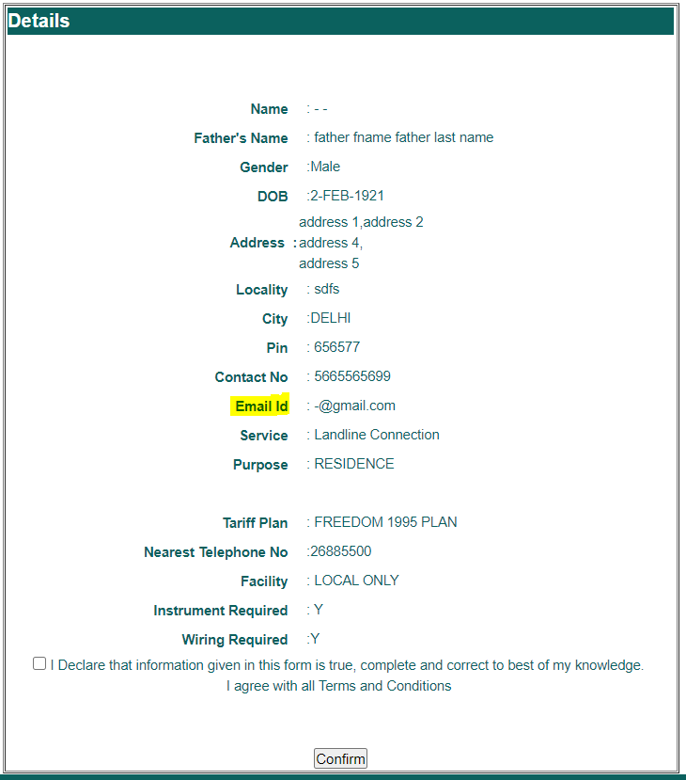
Form based testing
Fault 3: Accepting invalid Email ID

Slide 16
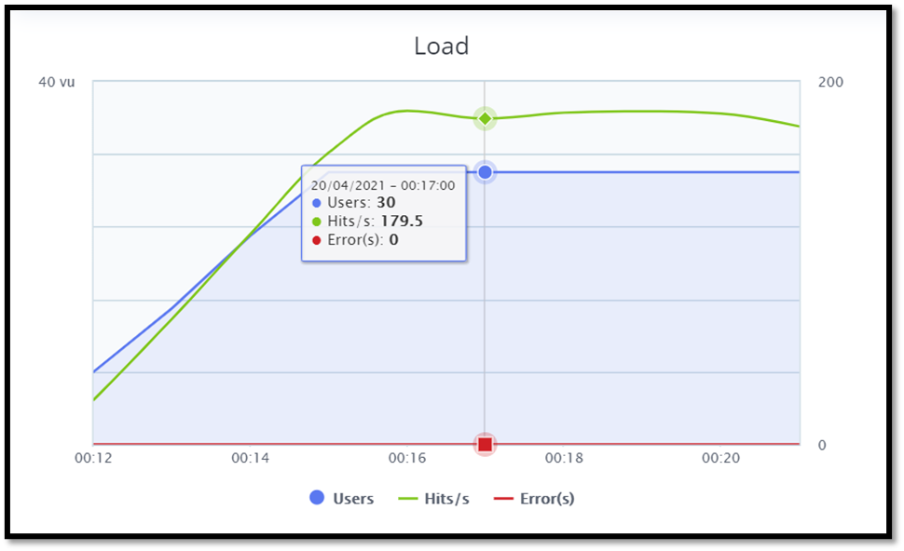
Performance testing
MTNL Website load Test Graph (Using Blaze Meter)
The average throughput achieved is 146.71 Hits/sec.

Slide 17
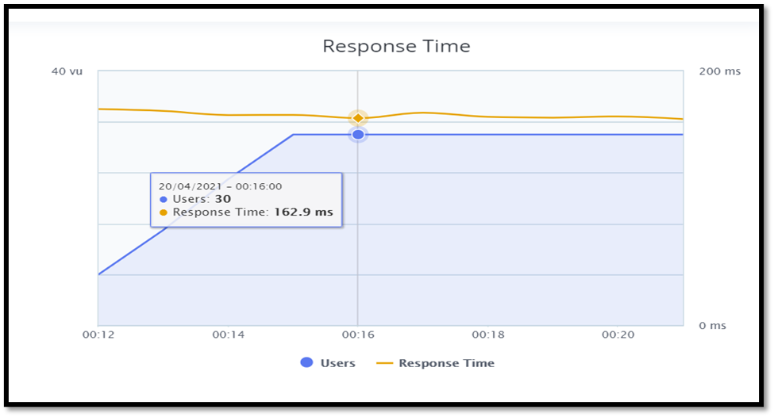
Performance testing
MTNL Website Response Time Graph
The average response time achieved is 164.52 millisecond.

Slide 18
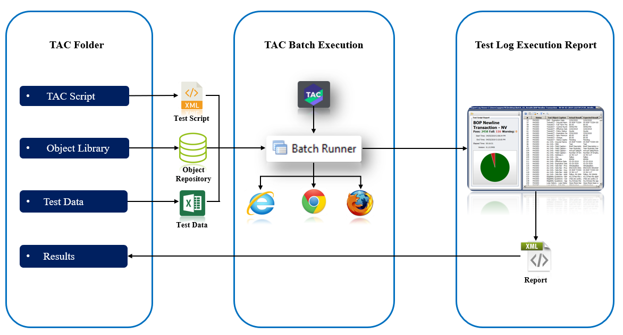
Database Testing
Test Automation Center Framework

Slide 19
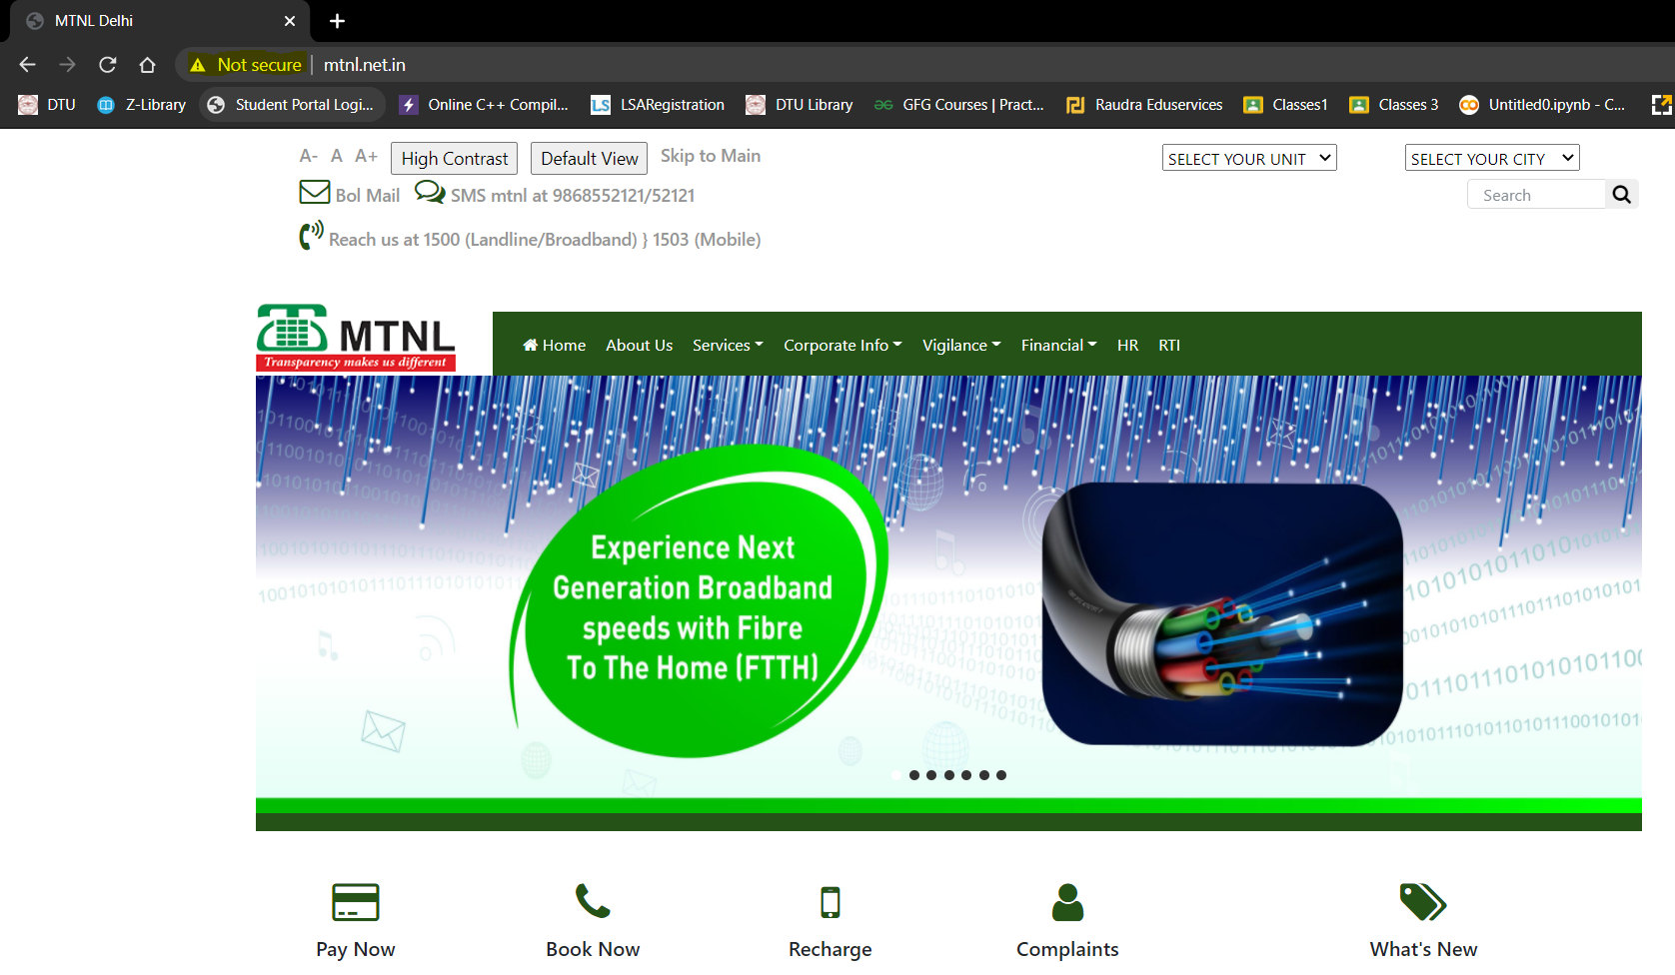
Security Testing

Slide 20
Security testing
Reasons for Website not Secure:
If a website’s URL begins with HTTP, it means the connection is insecure, which triggers the “Not Secure” warning.

Slide 21
Security testing
Possible Solutions to make it Secure are as follows:-
By installing an SSL (Secure Socket Layers) Certificate.
By forcing HTTPS.

